Slide 1
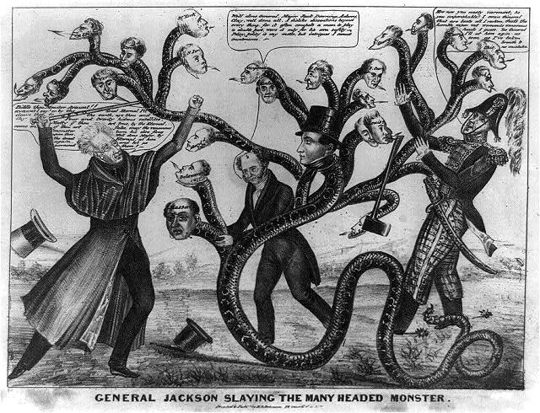

Slide 2
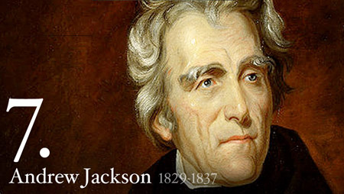
Age of Jackson
Champion of the Common Man
or King Andrew?
Notes:
Themes: The election to the presidency of the frontier aristocrat and common person’s hero, Andrew Jackson, signalled the end of the older elitist political leadership represented by John Quincy Adams. A new spirit of mass democracy and popular involvement swept through American society, bringing new energy as well as conflict and corruption to public life.
Theme: Jackson successfully mobilized the techniques of the New Democracy and presidential power to win a series of dramatic political battles against his enemies. But by the late 1830s, his Whig opponents had learned to use the same popular political weapons against the Democrats, signaling the emergence of the second American party system. While they represented different constituencies and to some degree different ideologies, the Democrats and Whigs both carried forward the legacy of American republicanism.
Theme: Amidst the whirl of democratic politics, issues of tariffs, financial instability, Indian policy, and possible American expansion into newly independent Texas indicated that difficult sectional and economic problems were festering beneath the surface that were not being very successfully addressed.

Slide 3
jackson
Jackson will be our first (but not last) war hero president.
  Remember his role in the war of 1812, Battle of New Orleans, and at GA/FL line
Jackson will bring new emphasis on democracy (rather than republic) but will also disregard precedent and, some will argue, the law
He was a war hero, a war criminal, and our 7th president.

Slide 4
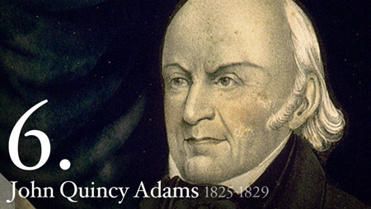
Election of 1824
4 candidates, no political parties
  John Q. Adams
  Henry Clay
  Andrew Jackson
  William Crawford
No winner in the electoral college – vote goes to the House of Reps
  Clay tells supporters to choose Adams b/c Adams supports the American System
    Clay will also be named Secretary of State as part of the deal
Notes:
Adams was the secretary of state who proposed the Monroe Doctrine, the sixth president, and a noted opponent of slavery in the House of Representatives.
He grew up at his father’s side and early on began keeping detailed diaries that form a memorable record of his thoughts and experiences. In 1794 he became minister to the Netherlands, the first of his numerous diplomatic assignments.
Regarded as a traitor by Federalists for supporting Jefferson’s embargo, he also aroused Jackson’s hatred, even though he was Old Hickory’s only cabinet supporter in the Monroe administration.
After leaving the presidency, he planned to retire to write history but was elected to Congress and returned for eight successive terms. “Old Man Eloquent” was contentious and sarcastic in his speeches against the “gag rule.” In 1841 he won the famous Amistad court case on behalf of black slaves who had revolted and taken command of a slave ship.
Quote: “When I came to the Presidency the principle of internal improvement was swelling the tide of public prosperity.…The great object of my life therefore as applied to the administration of the government of the United States has failed. The American Union as a moral person in the family of nations is to live from hand to mouth, to cast away instead of using for the improvement of its own condition, the bounties of Providence, and to raise to the summit of power a succession of Presidents the consummation of whose glory will be to growl and snarl with impotent fury against a money broker’s shop, to rivet into perpetuity the clanking chain of the slave, and to waste in boundless bribery to the West the invaluable inheritance of the public lands.” (Letter, 1837)
reference: Paul C. Nagel, John Quincy Adams: A Public Life, a Private Life (1997).
When we last caught up with Jackson, he was winning the Battle of New Orleans shortly after the end of the War of 1812. He continued his bellicose ways, fighting Indians in Florida, although he was not actually authorized to do so, and became so popular from all of his Indian killing that he decided to run for president in 1824.

Slide 5
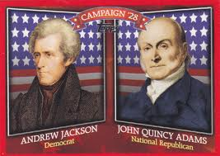
Effects of the Election of 1824
Jackson calls this a corrupt bargain b/c he won the popular vote
  Jackson’s supporters create the Democratic Party to oppose Adams’s policies
  NO EVIDENCE of actual bargain. BUT: J.Q. Adams is unable to accomplish anything in office (no veto b/c no power)
End of the Era of Good Feelings
  4 years of political fighting
  begins!
  Jackson campaigns this
  entire time
Notes:
between 1820 and 1850, this started to change. State legislatures lowered or else eliminated the property qualifications for voting, which allowed many more people to vote, so long as they were, you know, both white and male. the whole idea of owning land as a prerequisite for voting is sort of Jeffersonian. An individual who works his own land can be truly independent because he doesn't need to rely upon markets to acquire stuff or, God forbid, wages to give him money with which to buy stuff.
No, he makes his own stuff, and he doesn't need anybody... except for slaves, and also women to make shoes and clothes and to cook food and also make children.
Contrast Adams and Jackson as symbols of the old and new politics. Show how the Jacksonians used the “elitist” and “corrupt” election of 1824 to arouse popular feelings for their sweeping democratic victory in 1828.
references: Samuel Bemis, John Quincy Adams and the Union (1956); Robert V. Remini, Andrew Jackson and the Course of American Freedom (1981).

Slide 6
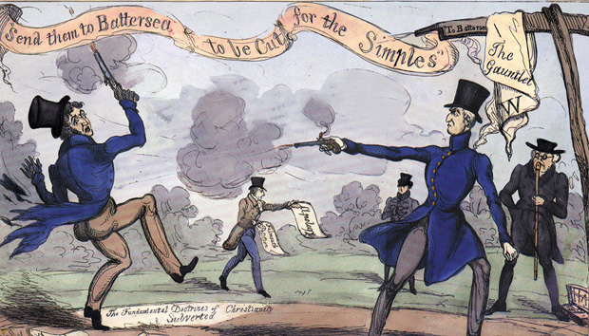
Duelers gonna duel, duel, duel, duel
Jackson was in 13 duels that we know of
Dickson duel, “If he had shot me through the brain, sir, I should still have killed him.”

Slide 7
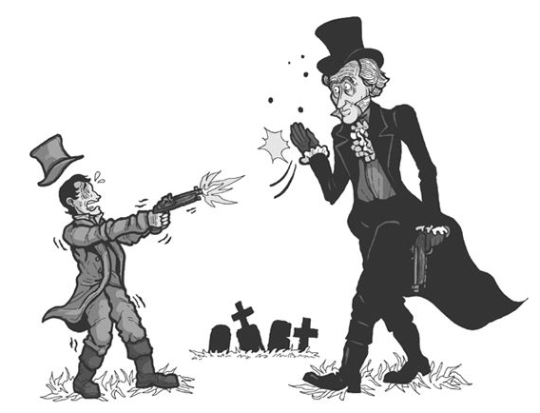
Given how good Jackson was at dueling, perhaps this is a better image

Slide 8
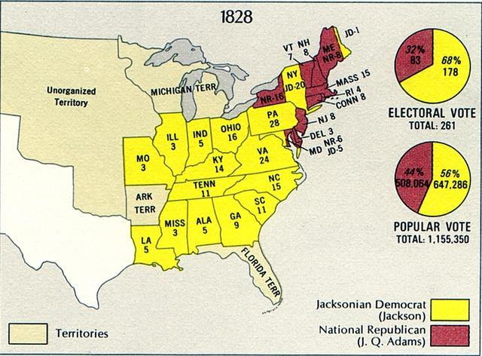
Election of 1828
States have eliminated property ownership requirement for voting
  NEW REQUIREMENTS: white male, aged 21+
  More people will be eligible to vote!
    New electorate will
    support Jackson!
Notes:
Analyze the rise of mass politics and popular democracy. Focus on the increasing democratic American celebration of “the people” in opposition to entrenched elites, as well as specific political innovations: the end of property qualifications, political conventions, political machines, and the spoils system.
reference: Harry L. Watson, Liberty and Power: The Politics of Jacksonian America (1990).
The jacksonian coalition: democrats will be more welcoming to immigrants b/c they don’t live in cities in the first place!
The Planter Elite in the South
People on the Frontier
State Politicians – spoils system
Immigrants in the cities.

Slide 9
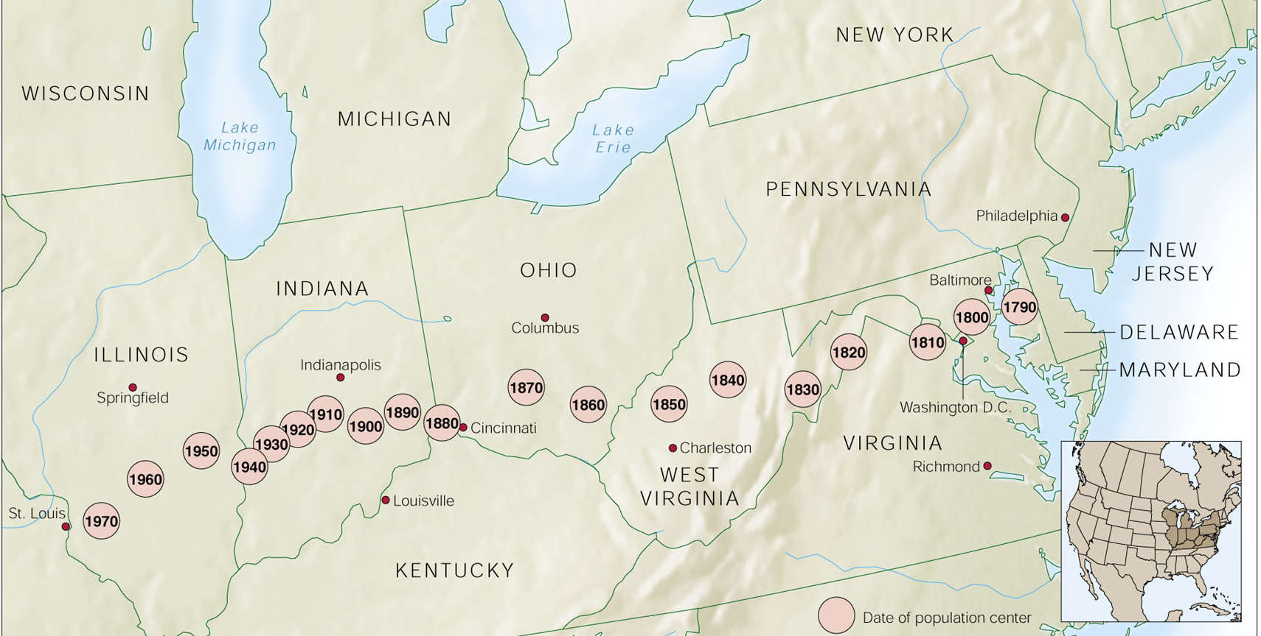
Center of nation’s population moves west
Notes:
by the time Jackson became president in 1829, every state except for North Carolina, Virginia, and Rhode Island had already gotten rid of their property requirements. In fact, that's probably why he got elected.

Slide 10
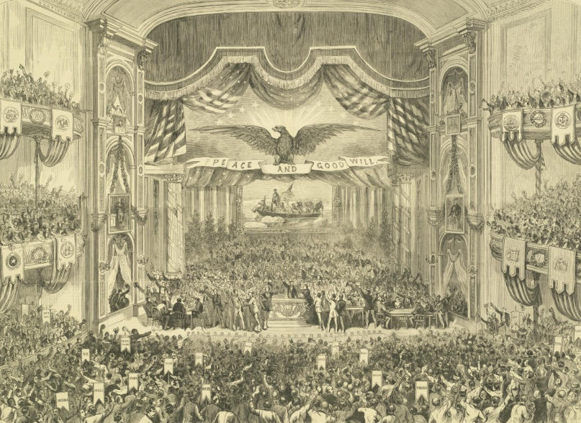
Elections of 1828,1832
1828 Candidates:
  Andrew Jackson – Democrat
    Appealed to the common man – war hero, westerner
  John Q. Adams – National Republican
    Unpopular, many thought he was out of touch
Jackson will be reelected in 1832
  This election is important b/c it is the first time parties use national nominating conventions to select a candidate

Slide 11
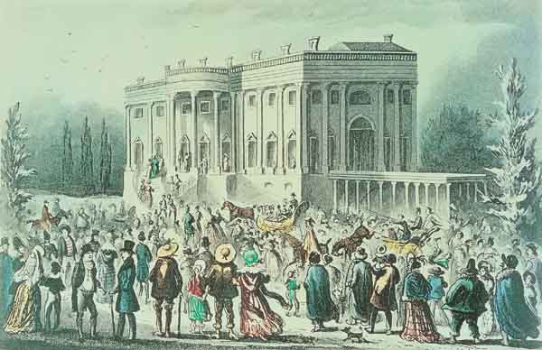
Notes:
President Jackson was known for opening up the White House to visitors of all classes. His inauguration party lasted for hours as throngs of people from packed streets pushed into the White House. This painting captures the rowdy scene with its broken furniture and stifling crowd. “King Mob” was so dangerous that Jackson had to be taken out through a window and it took an entire week to scrub and clean the White House after the party.

Slide 12
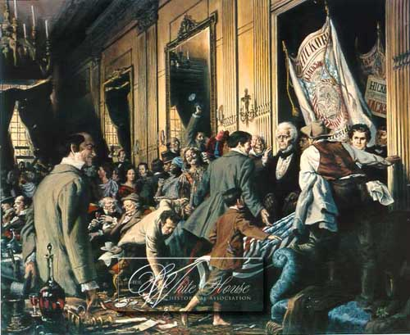
Jackson’s inauguration
Notes:
President Jackson was known for opening up the White House to visitors of all classes. His inauguration party lasted for hours as throngs of people from packed streets pushed into the White House. This painting captures the rowdy scene with its broken furniture and stifling crowd. “King Mob” was so dangerous that Jackson had to be taken out through a window and it took an entire week to scrub and clean the White House after the party.

Slide 13
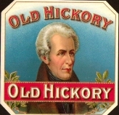
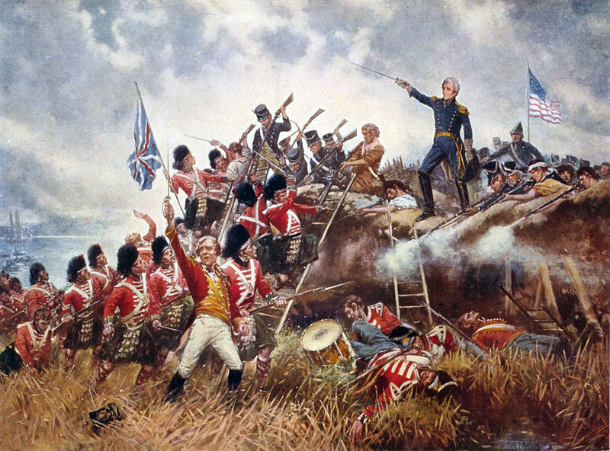
Jackson’s Presidency
Jacksonian Democracy – political power exercised by ordinary Americans – more democracy (for white men)
Was the “Common Man’s” President
  “Old Hickory,” the anti-establishment War hero
Great Silence – Jackson owned slaves, refused to deal with the issue nationally

Slide 14
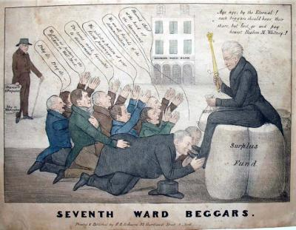
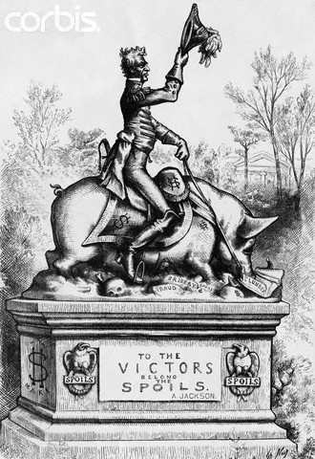
The Spoils System
Created spoils system – practice of giving gov’t jobs to friends & supporters
  Kitchen Cabinet – group of friends who became his primary set of advisors, NOT his “official” Cabinet
Notes:
Discussion question: What were the advantages and disadvantages of the new politics of mass democracy? Were such things as the spoils system, party machines, and hoopla-driven campaigns inevitable accompaniments of popular democracy, or could “the people” have been mobilized by a more open and less partisan system?

Slide 15
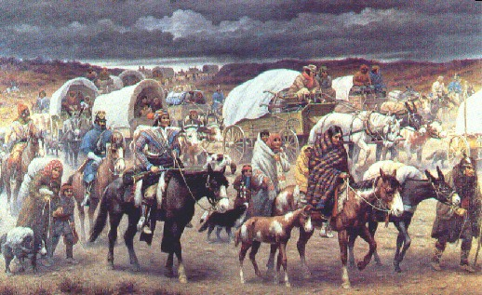
Robert Lindneux 1942

Slide 16
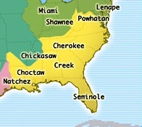
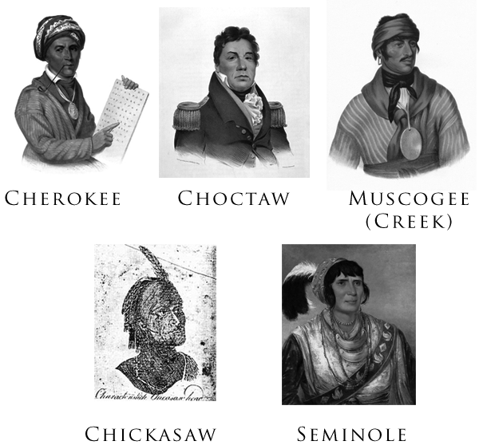
Native Americans
“5 Civilized Tribes”
  Lived in southeastern US
  Cherokee, Choctaw, Chickasaw, Seminole, Creek
  Adopted aspects of American culture – but many whites still considered them inferior
Farmland is becoming scarce – whites want their lands!
Notes:
• Two basic ideas among whites about how to deal with the Indian “problem:” Civilization or Removal o Civilization means that the Native Americans would become farmers; would convert to Christianity; would own individual portions of land, rather than share; would learn to read and write English; would ultimately become Americans.
o Removal was based on the idea that that civilization was never going to succeed and the only thing to do was to find some place in the West to settle Native Americans.

Slide 17
What to do with the Indians:
Debate
  Assimilate them?
  Co-exist with them?
  Remove them to the west?
  Create separate nations for them?
Jackson believes assimilation won’t work, refuses to co-exist with them
Notes:
• George Washington and his administration pushed for civilization, thinking that they could solve the “Indian problem” by civilizing the tribes and assimilating them into the states. But by the 1820s, racial categories had evolved and it seemed more and more clear that whites would never accept Native Americans as equals, and would never respect their right to their land.

Slide 18
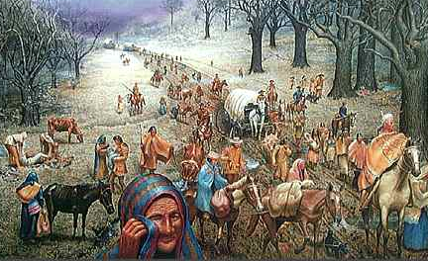
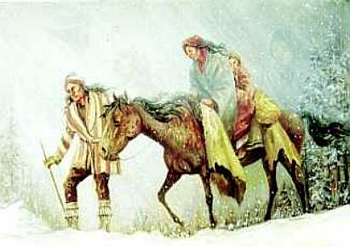
Indian Removal Act (1830)
Called for relocation of the 5 Civilized Tribes to the Indian Territory (Oklahoma)
Creek, Chickasaw, Choctaw are marched west by the US Army
  Many die from exposure, malnutrition, disease
Seminoles hide in Florida swamps, will fight back against US soldiers
  Some moved west, many will remain in Florida

Slide 19
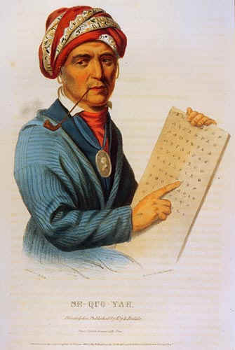
The Cherokee
Challenge the Indian Removal Act in the courts
  Sued the US gov’t – saying they had right to be treated as an independent country
  Supreme Court rules against the Cherokee here
State of Georgia begins enforcing the Act – told Cherokee & their white supporters to leave the land

Slide 20
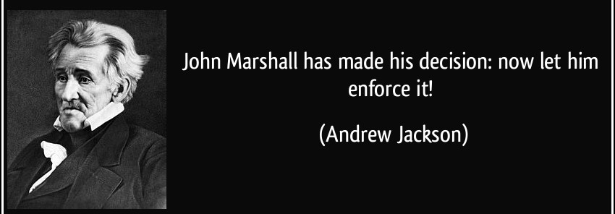
Worcester v. Georgia
  Samuel Worcester brought suit on behalf of himself & Cherokee to stop Georgia
Supreme Court rules with Cherokee!
  Georgia is not entitled to regulate the Cherokee nor invade their lands!
Jackson Will ignore the Court, begin plans for removal of the Cherokee

Slide 21
Trail of Tears
Gov’t will sign treaties Cherokee leaders who favored relocation to get around the Court’s ruling
18,000 Cherokee forced to march west
  4,500 (1/4) of the Cherokee will die
  Known as the Trail of Tears

Slide 22
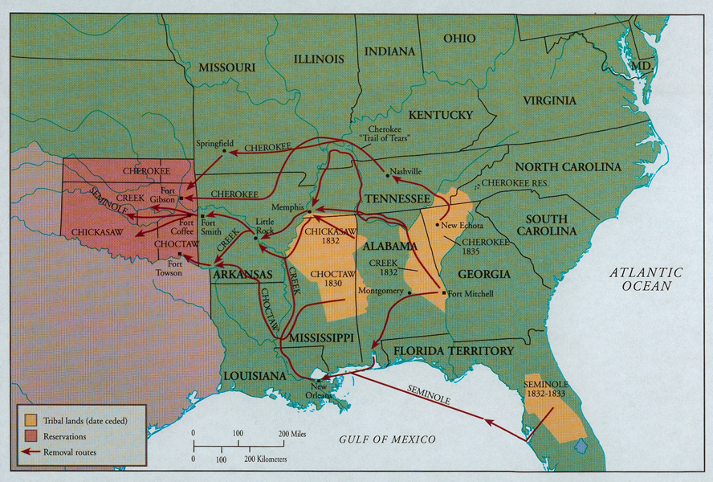
Indian Removal Act – lands forfeited & new territories

Slide 23
Skills block
1. What group benefited most directly from the migrations depicted in the map?
2. The migrations had the least effect on what group?
3. Based on the map, what can you infer were the major modes of transportation available in the regions of migration during this time period?

Slide 24
SHEG: Indian Removal Act

Slide 25
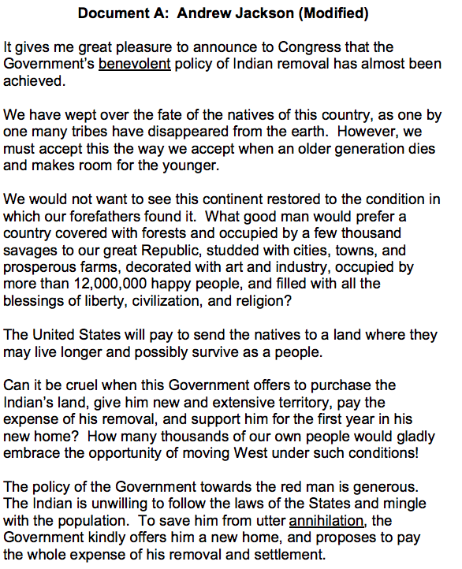
(Sourcing) What do you already know about President Jackson’s feelings about Indian Removal? What do you predict he will say in this speech?
2. (Contextualization) Why does Jackson think the United States was better in 1830 than in 1609?
3. (Contextualization) Why does Jackson think that the Cherokee will be better off in Indian Territory?
4. (Close reading) Why does Jackson think his policy is kind and generous?

Slide 26
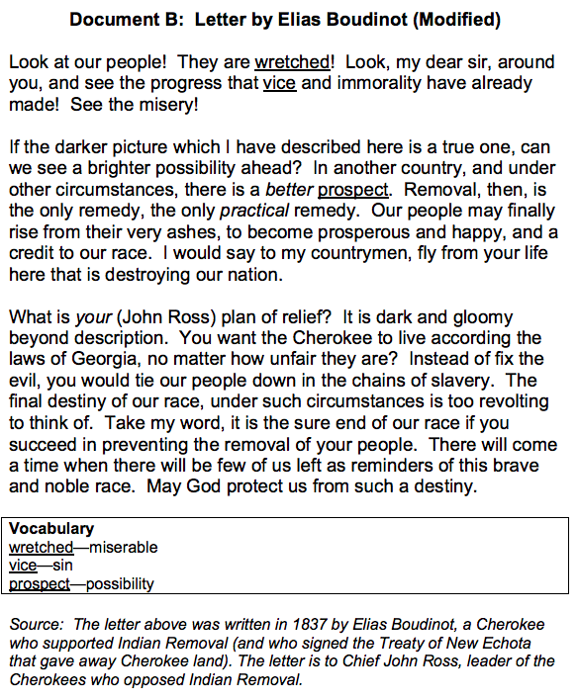
1. (Sourcing) Who is Elias Boudinot? What do you predict he will say about Indian Removal?
2. (Contextualization) What was life like for the Cherokee in Georgia, according to Boudinot?
3. (Contextualization) What does Boudinot hope will happen if the Cherokees move west?

Slide 27
Indian Removal Act discussion
Why did Jackson or Boudinot think Indian Removal was in the best interest of the Cherokee?
Do you believe them? What parts sound sincere or believable?
Why might some people at that time have believed that Indian Removal was a reasonable policy?
How have our attitudes changed/ stayed the same since the 1830s?
How might the United States be different if the Trail of Tears never happened?

Slide 28
activity
Using your notes and textbook, Create a cause and effect chart for Indian Removal.

Slide 29
Indian removal
Causes
Effects
expansion of cotton,
westward migration,
competition for land,
gold,
racism,
Jackson's refusal to follow the Supreme Court's decision, protection
Trail of Tears;
disease;
lack of supplies & livestock;
geographic, economic, political challenges of the new territory

Slide 30
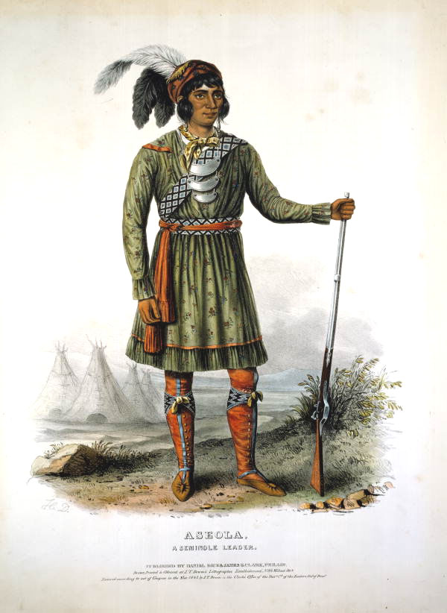
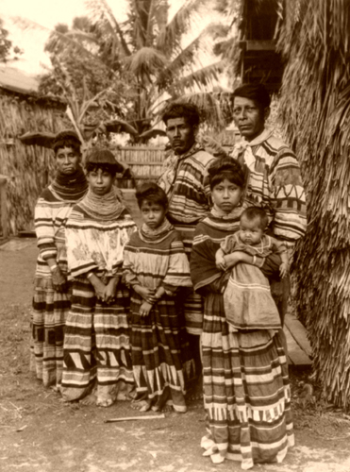
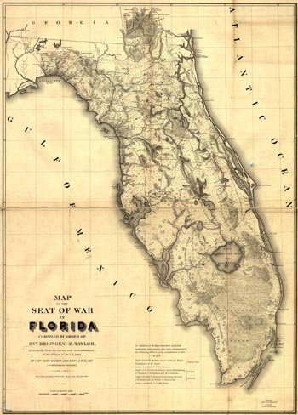
SEMINOLES
Major exception to Jackson’s Indian policies
Resisted and were mostly successful
Second Seminole War;
led by Chief Osceola
Escaped, hid out in the Everglades and adopted an an entire new lifestyle

Slide 31
seminoles
Major exception to Jackson’s Indian policies
Resisted and were mostly successful
Second Seminole War;
  led by Chief Osceola
  Escaped, hid out in the Everglades and adopted an an entire new lifestyle
Notes:
Major exception to Jackson’s Indian policies
Resisted and were mostly successful
Second Seminole War;
led by Chief Osceola
Escaped, hid out in the Everglades and adopted an an entire new lifestyle

Slide 32
Tariffs Pose Problems
Tariff of 1828 raised tariffs to highest
levels yet
  Supported by Northern industries – encouraged people to “buy American”
  Southerners opposed the tax
    Forced them to buy more expensive Northern goods rather than cheaper British goods
    Opposed the interference with their trade – Britain buys less cotton when they make less money here
Notes:
Tariff of 1824 had raised rates from 23% to 37%
Tariff of 1828 increased some rates to 45%
Protested as the “Tariff of Abominations”
SC protest: Calhoun’s “SC Exposition and Protest”
Theory of nullification reborn
Protection against the “tyranny of the majority”
The tariff raised prices on imported manufactured goods made of wool and iron, which enraged South Carolina, because they'd put all their money into slavery, and none into industry.
Tariff of 1832 passed
SC passes Ordinance of Nullification – seems to be only solution to solve both protective tariff issue & impending problem of abolition of slavery
Jackson issues Proclamation to People of SC
Defines nullification as “treason”
No defiance of federal law will be permitted!
Threatens force
Compromise:
Tariff of 1833 = gradual tariff reductions
Force Bill – gives P power to use force to stop treasonous activities
SC repeals its Nullification Ordinance BUT then goes on & nullifies the Force Bill!

Slide 33
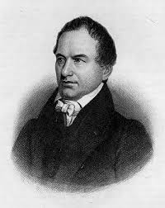
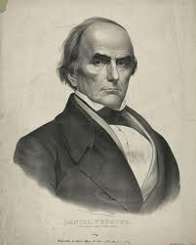
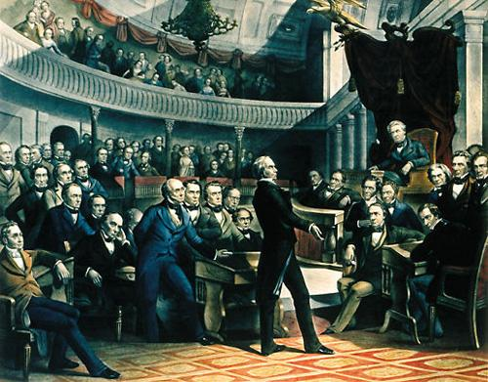
Webster-Hayne Debate
Webster-Hayne Debate: Senate debate over the roles of tariffs and state vs. federal power
  Haynes – South
  Webster – North
Notes:
Prime Reflection of Sectional Conflict
Webster:
“Liberty and Union, now and forever, one and inseparable.”
….nothing more than a “rope of sand.”
Impact of Webster’s oratory in the N?
JEFFERSON DAY BANQUET:
Jackson:
Our Federal Union—it must be preserved.
Calhoun:
The Union, next to our liberty, most dear.
Webster’s impact:
40,000 copies printed up – even printed up in schoolbooks
Arguments for “union” firmly established in minds of Northerners (like Lincoln)
Banquet: Jackson had been keeping quiet & heard of scheme by Southern states’ rights leaders to force him out on the issue at the Jefferson Day banquet in 1830. They planned to give a series of toasts in honor of Jefferson – STATES RIGHTIST - & hoped Jackson, the “Southerner” would do the same.
So…..he said the above instead & Calhoun then forced to give the above response.
Jackson actually favored states rights but NOT if it would lead to disunion. He believed that nullification threatened the Union and therefore opposed it.
Calhoun differed from Jefferson and Madison in explicitly arguing for a state's right to secede from the Union, if necessary, instead of simply nullifying certain federal legislation. James Madison rebuked supporters of nullification, stating that no state had the right to nullify federal law.
In May 1830, Jackson discovered that Calhoun had asked President Monroe to censure then-General Jackson for his invasion of Spanish Florida in 1818. Calhoun was then serving as Monroe’s Sec. of War (1817–1823). Jackson had invaded Florida during the First Seminole War without explicit public authorization from Calhoun or Monroe. Calhoun's and Jackson's relationship deteriorated further.
Calhoun defended his 1818 position. The feud between him and Jackson heated up as Calhoun informed the President that he risked another attack from his opponents. They started an argumentative correspondence, fueled by Jackson's opponents, until Jackson stopped the letters in July 1830.
By February 1831, the break between Calhoun and Jackson was final. Responding to inaccurate press reports about the feud, Calhoun had published the letters in the U.S. Telegraph.

Slide 34
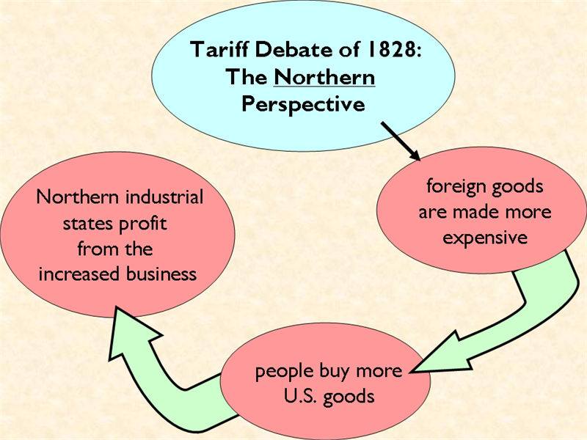

Slide 35
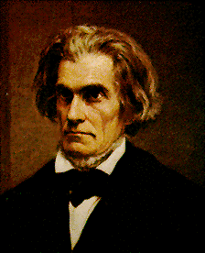
Nullification Crisis
South considers the new Tariff of 1832 the
Tariff of Abominations
  Britain reduced import of American cotton
John C. Calhoun wrote South Carolina Exposition & Protest
  Outlining South Carolina’s opposition to the tariff
  Proposed SC use nullification
  SC threatened to secede from the
  Union if the gov’t tried to enforce
  the tariff in SC
Notes:
Calhoun was among Clay’s young “war hawks” who advocated the War of 1812 and an ardent nationalist in the years following the war. After seeking the presidency in 1824, he settled for the vice presidency under Adams and then under Jackson.
His extended feud with Jackson began when Jackson learned that Calhoun had opposed Jackson’s invasion of Florida in cabinet discussions. It reached fever pitch when Calhoun’s socially conscious wife snubbed Peggy Eaton, forcing Calhoun’s resignation from the vice presidency.
Once he became a purely sectional figure, Calhoun spent much time writing political theory, including his doctrine of the “concurrent majority.” He also proposed the creation of a dual presidency, with a northern president and a southern president each having mutual veto power.
He died shortly after his last speech was read for him in the Senate during the debate over the Compromise of 1850. His last words were, “The South, the poor South.”

Slide 36
"John Calhoun, if you secede from my nation, I will secede your head from the rest of your body." As The Week says, this one is unverified, but given Jackson's character and relationship with Calhoun, it's likely.
Notes:
This goes back to the Eaton Affair, Sec.of War John Eaton married Peggy O’Neale- she had a questionable background.
Cabinet members wives refused to be nice to Peggy
John Calhoun’s (Vice President) wife led the group that refused to attend social events that Peggy would attend.
Pettycoat wars
Jackson ordered cabinet and wives
to attend a dinner party
Calhoun said his wife would not attend
Jackson threatened to fire any cabinet member whose wife did not attend
Jackson fired all cabinet members except Martin Van Buren---he did not have a spouse and he came to party and was nice to Peggy
This is one of the issues that drove a wedge between Calhoun and Jackson

Slide 37
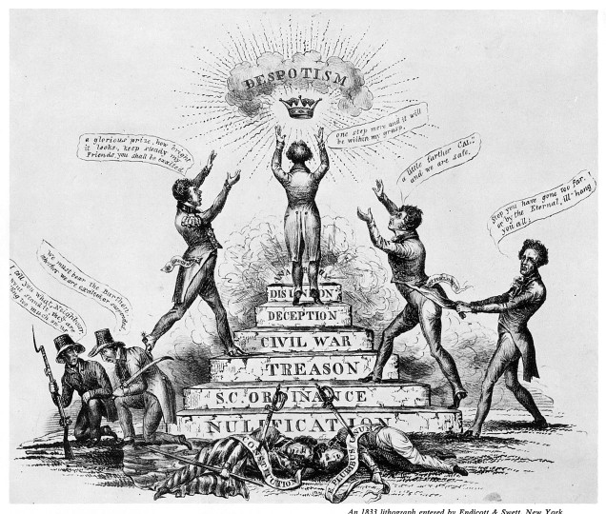
Nullification Crisis
Jackson threatened to use force against SC
Henry Clay organized a compromise
  Gradually lower the tariff, SC agrees to follow the law
States rights vs. Federal power

Slide 38
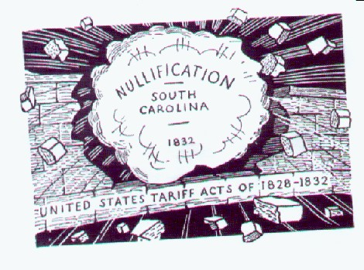

Slide 39
Bank Wars
Andrew Jackson, fresh off his crimes against humanity, felt pretty confident. He felt confident enough to challenge the largest corporation in the United States, the Bank of the United States.
Remember, the second bank of the US was passed as part of the American System

Slide 40
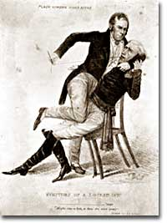
Bank Wars: The Second National Bank
Despite McCulloch v. Maryland, opponents (including Jackson) still claimed the Bank was unconstitutional
  Thought it only supported wealthy, merchants, industries
  Believed the state banks were more likely to support poorer farmers in South and West
Jackson's actions with regard to the Second Bank of the U. S. resulted in his censure by Congress for abuse of power. In this cartoon, Henry Clay is sewing Jackson's mouth shut.
Notes:
Unconstitutional – he just ignores McCulloch decision of Supreme Ct.
A monopoly on public funds
Small banks’ profits were limited
Favors hard money; doesn’t trust paper
Bank favors the rich at the expense of the poor
Run by private citizen & handful of rich men
“Un-American” – foreign investors owned small portion of the bank
Clay & Webster try to use this against him & seek early renewal of Bank’s charter in 1832
Jackson, as predicted, vetoed the rechartering bill

Slide 41
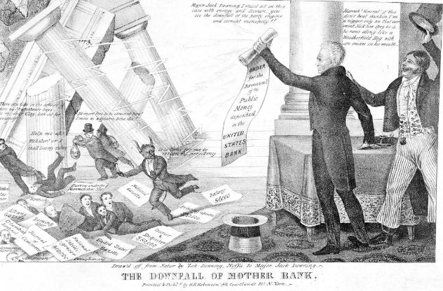
Bank wars
“The bank, Mr. Van Buren, is trying to kill me. But I will kill it.” Three days later, Jackson announced his veto of the bank charter.
Jackson destroying the “Devil’s bank”

Slide 42
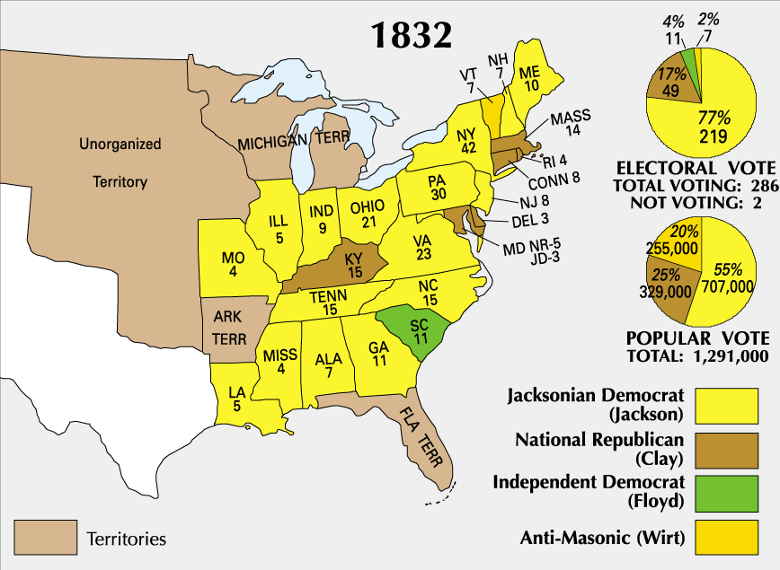
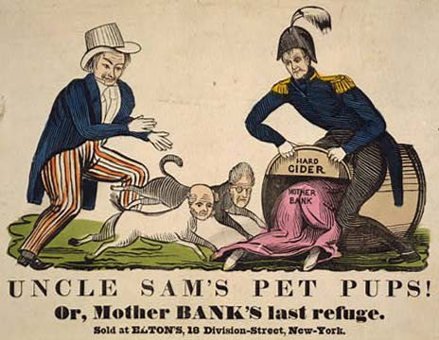
Jackson and the National Bank
1832: Time to consider renewing the National Bank’s charter
  bank leader Nicholas Biddle persuaded Congress to pass a bill extending the life of the Second U.S. Bank for 20 years.
  Jackson will veto the charter – and is reelected
    Believed Americans supported his bank policies
Jackson closes the National Bank
  Places the money in pet banks (selected
  state banks approved by Jackson)
  Leads to a monetary crisis!
Notes:
It’s an election year – Jackson makes the Bank a campaign issue
Veto message talks about the bank as an instrument to subvert democracy. Jackson set himself up as a defender of the lower classes by vetoing the Bank's charter.
Now, Whigs took exception to the idea that the president was somehow a more democratic representative of the people than the legislature, but in the end, Jackson's view won out. He used the veto power more than any prior president, turning it into a powerful tool of policy. Which it remains to this day, by the way.
These so-called "pet banks" were another version of rewarding political supporters that Jackson liked to call "rotation in office." Opponents called this tactic of awarding government offices to political favorites "the spoils system."
Anyway, these smaller banks proceeded to print more and more paper money, because, you know, free money. Like, between 1833 and 1837, the face value of bank notes in circulation rose from $10 million to $149 million, and that meant inflation. Initially, states loved all this new money that they could use to finance internal improvements, but inflation is really bad for wage workers. And also, eventually, everyone.

Slide 43
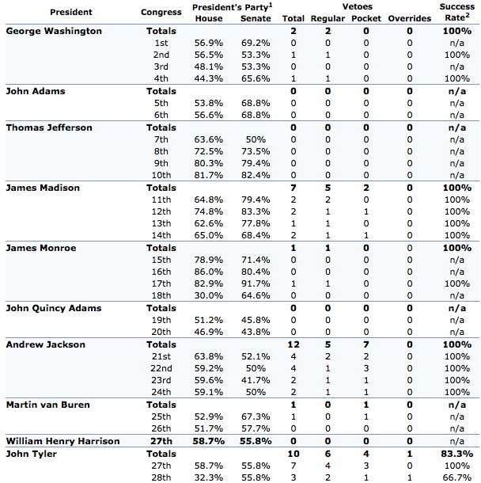
http://www.presidency.ucsb.edu/data/vetoes.php
Notes:
http://www.presidency.ucsb.edu/data/vetoes.php

Slide 44
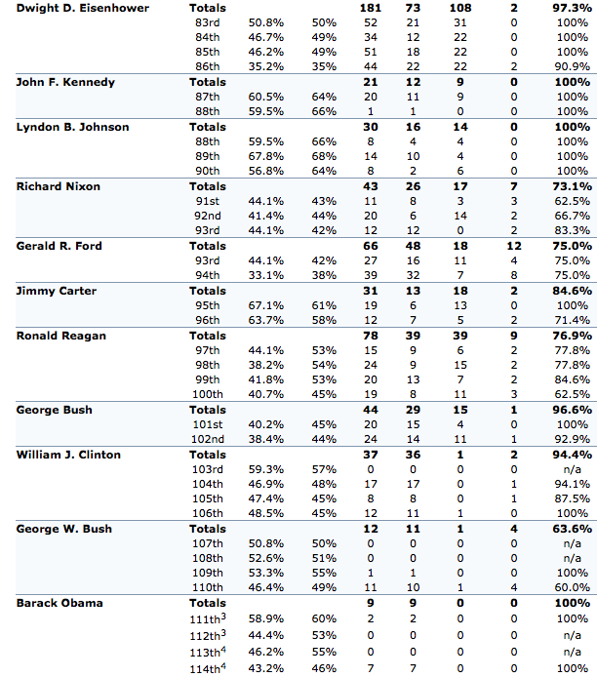
Last Update: Data through January 19, 2016 (114th Congress, 2nd Session)
Notes:
Last Update: Data through January 19, 2016 (114th Congress, 2nd Session)

Slide 45
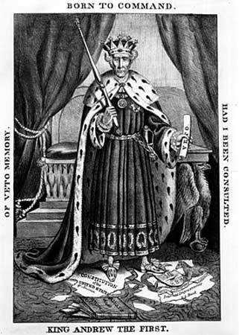
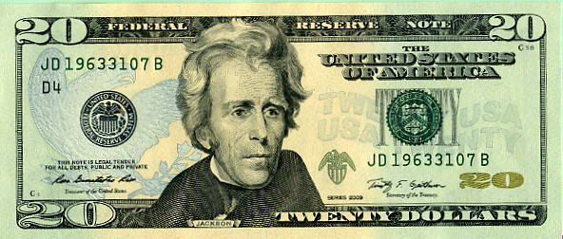
What do you think of President Andrew Jackson? Does he deserve to be on the $20?
Notes:
Appeared in Whig newspaper
This visual draws more interest than a printed article would
During his first term
Main Idea: Jackson has unconstitutionally expanded the power of the presidency
Discussion question: How was Jackson able to make the “Bank War” such an effective symbol of democracy and of his presidency? Why were his opponents, like Clay and Biddle, unable to counter his appeals, even when their arguments appeared to have economics and stability on their side?
In the end, Andrew Jackson probably was the worst American president to end up on currency, particularly given his disastrous fiscal policies

Slide 46
Jackson political cartoons
Cartoon | Symbols/individuals (list what you see) | Main idea (analysis
King Andrew (1833)
Slaying the Hydra (1836)
To the Victor belong the Spoils (1877)
Doctors are puzzled (1835)
Rats leaving Falling House (1831)
Downfall of the Bank (1833)

Slide 47
Jackson Political Cartoons
How do some of these cartoons reflect the major criticism of Andrew Jackson?
How do some of these cartoons reflect support for President Jackson?

Slide 48
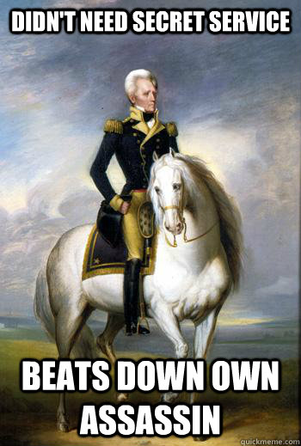
Live like you were dyin’
“I try to live my life as if death might come for me at any moment.” Though that may have been true, Jackson was also prepared to fight death tooth and nail. When an assassin tried to kill him in 1835, Jackson beat him in the face with his cane.
Notes:
One of the things that makes Andrew Jackson's presidency so interesting, and also so problematic, is that he was elected via a more democratic process, but he concentrated more power in the executive in a thoroughly undemocratic way.

Slide 49
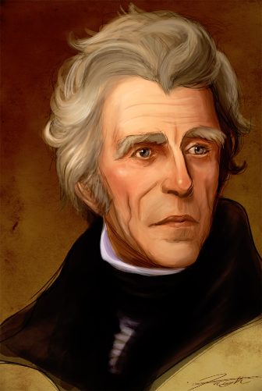
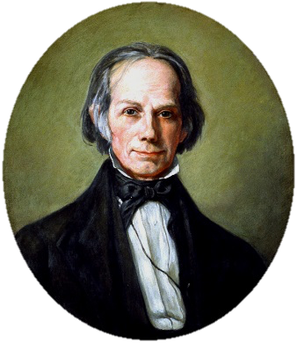
Two Party System (Again)
Two-party system returned in the 1832 election:
Dem-Reps → Natl. Reps.(1828) → Whigs (1832) → Republicans (1854)
Democrats (1828)
Whigs | Democrats
Business Oriented | Less comfortable with industrialization
Support Gov’t aid to economy | Government takes “laissez-faire” approach
Business / Planters/ Bankers | Farmers /Workers/ Entrepreneurs
Anglo-Saxon, Protestant | More religiously & ethnically diverse
“Active” involved gov’t | “Inactive” less-involved gov’t
Notes:
Jackson's Political Legacy:
--One of the most controversial presidents in history, Jackson's policies, particularly regarding the Bank, led to the formation of the so-called "Second Party System."
--Quickly, a rival party came to oppose Jackson's supporters--the Democrats--calling themselves "Whigs" after those in England who opposed the King and his imperial rule.
--Business-oriented, generally wealthy, and socially progressive, the Whigs were a national party, though they were more popular in the North. Some generalizations about the parties are helpful:

Slide 50
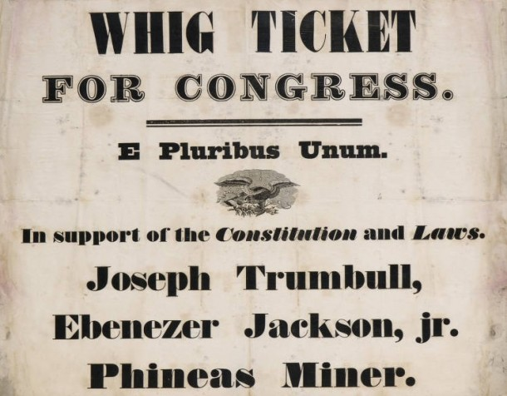
Whig Party
Forms during Jackson’s presidency
  Organized to:
    Oppose Jackson’s policies
    Support the American System
Leaders
  Henry Clay
  Daniel Webster
  John C. Calhoun
Notes:
So, the Whigs were big supporters of the American System and its active federal government. You know, tariffs, infrastructure, etc. The greatest support was in the northeast, especially from businessmen and bankers, who benefited from those tariffs and the stability provided by a national bank. And they also thought the government should promote moral character, because that was necessary for a person to act as a truly independent citizen.

Slide 51
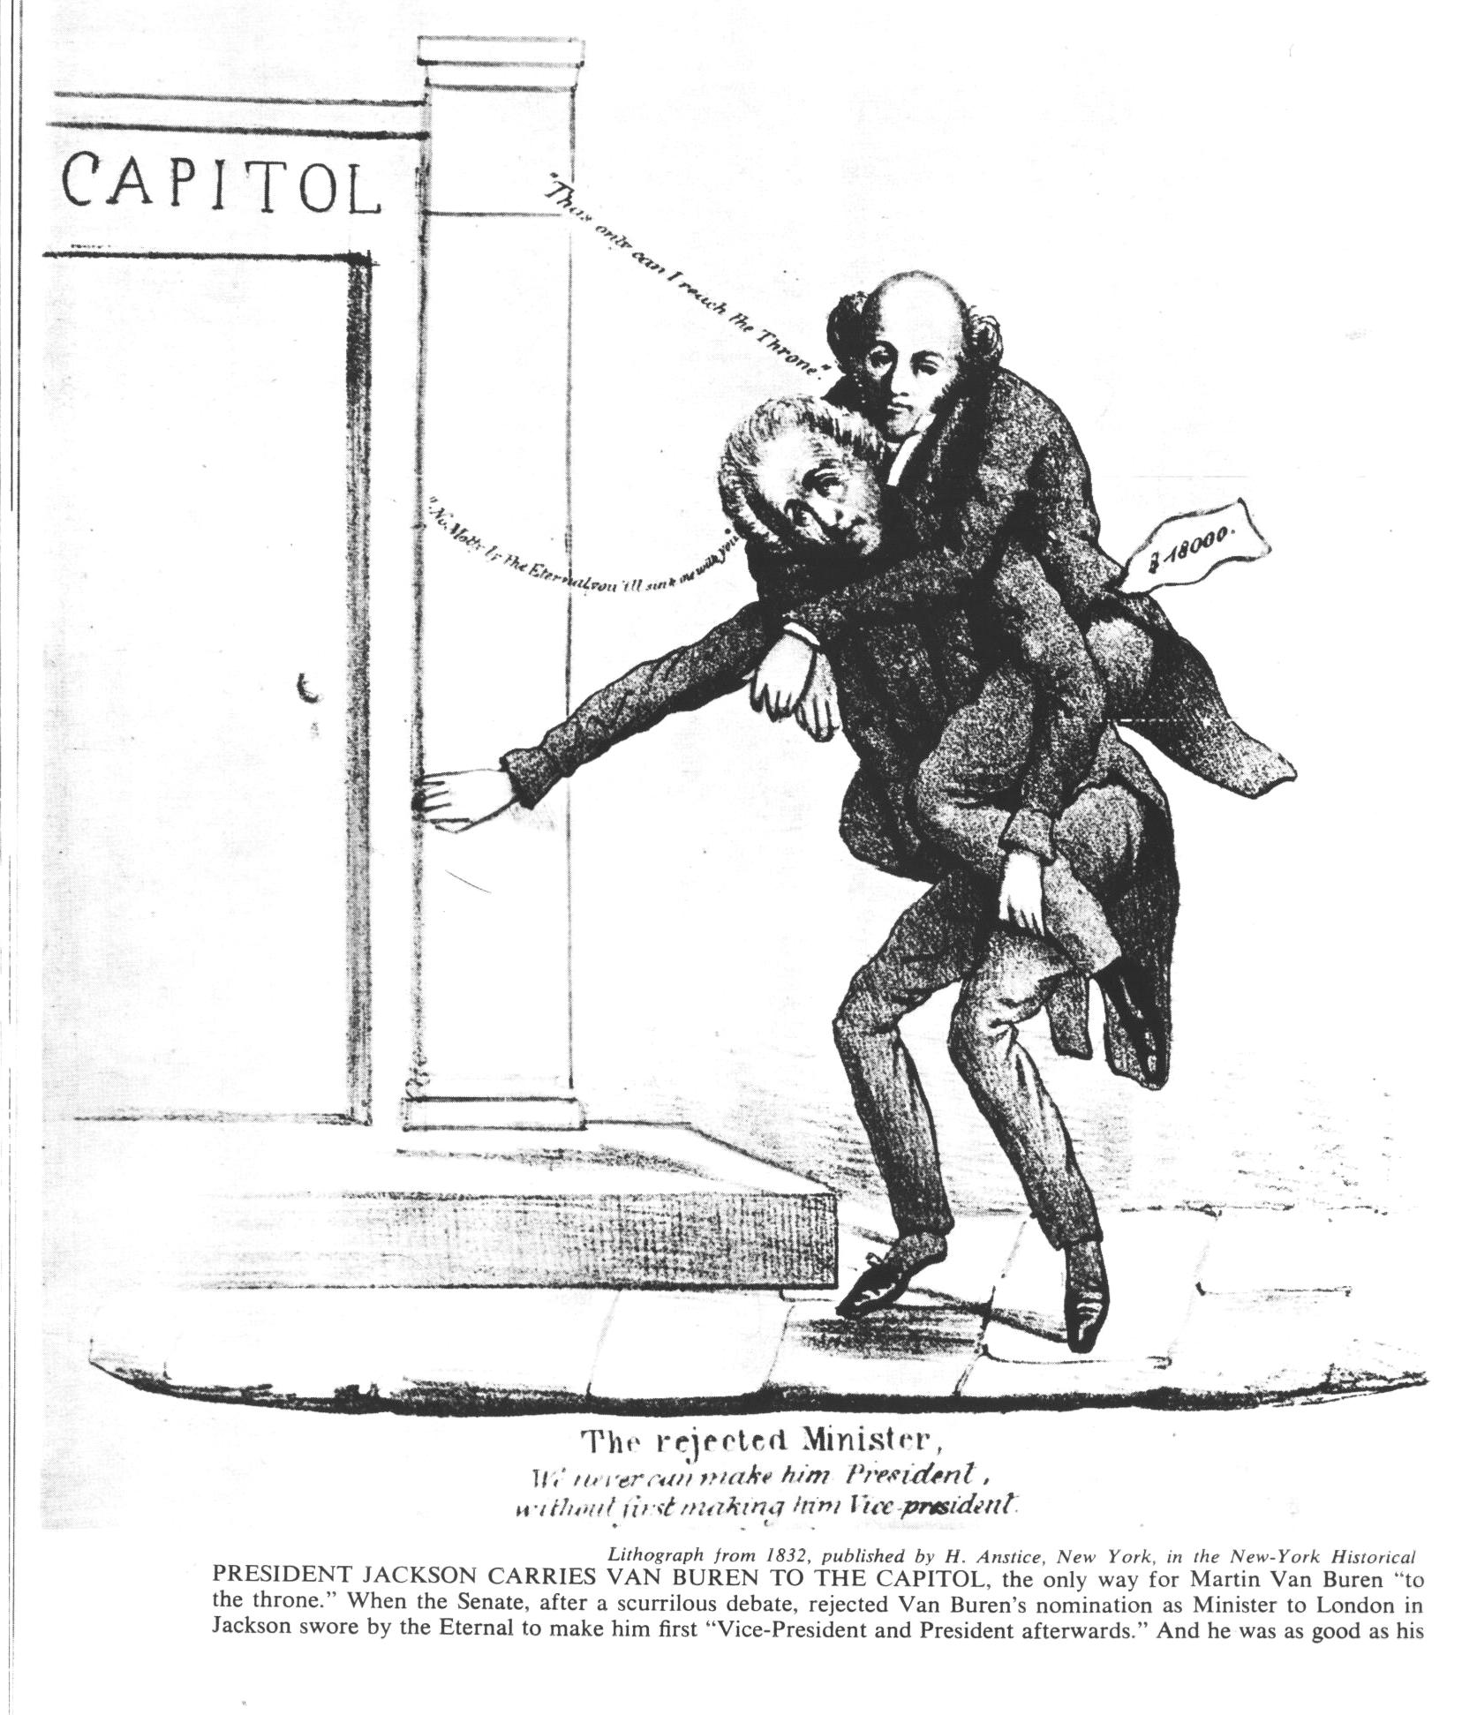
“PRESIDENT JACKSON CARRIES VAN BUREN TO THE CAPITOL, the only way for Martin Van Buren “to …the throne.” When the Senate, after a scurrilous debate, rejected Van Buren’s nomination as Minister to London… Jackson swore to the Eternal to make him first “Vice-President and President afterwards.”

Slide 52
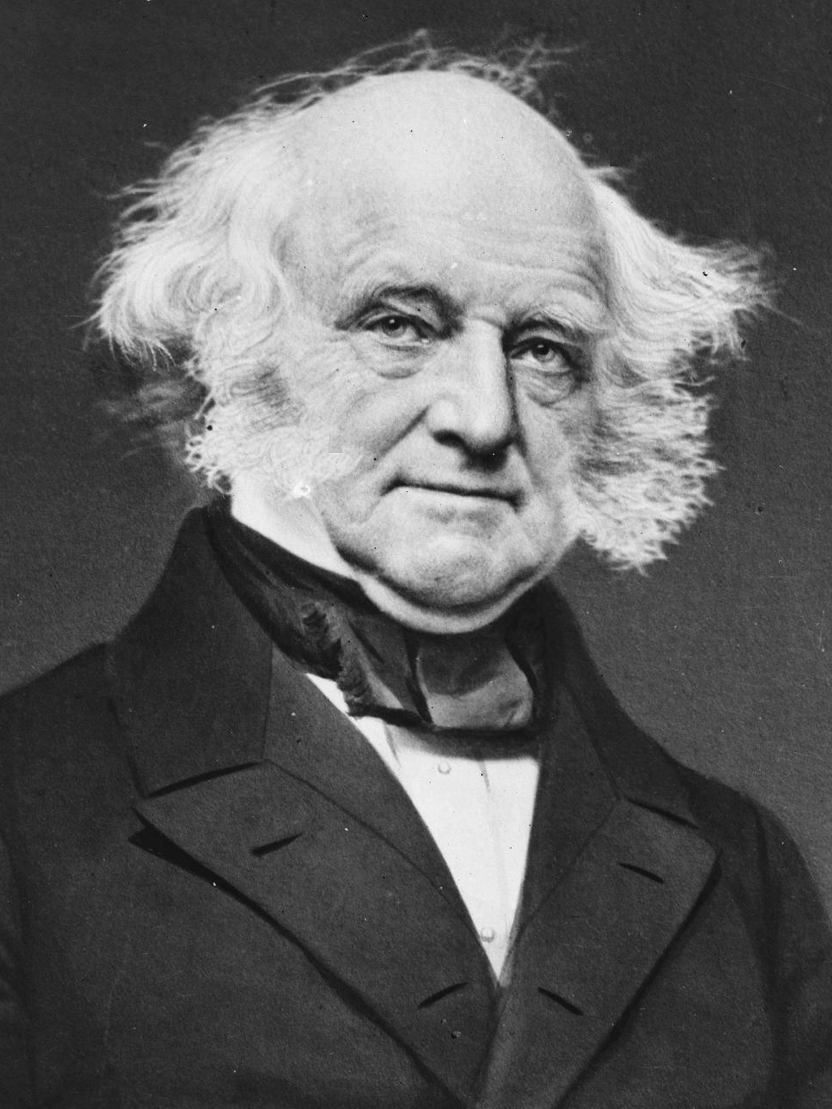
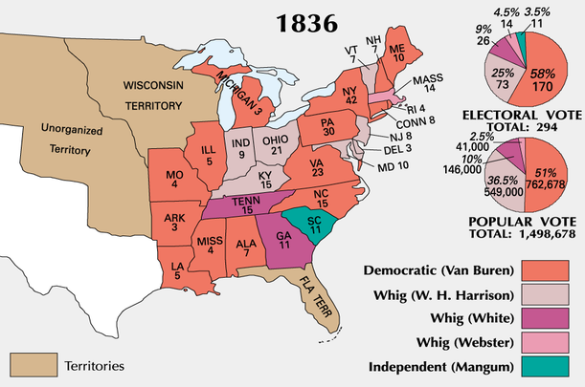
Martin van Buren
Had been Jackson’s VP
Will be elected President in 1836 – thanks to Jackson’s support (and Whig ineptitude)
Also thanks to Jackson’s bank policies, “Panic (depression) of 1837”
Notes:
The subsequent depression lasted until 1843, and Jackson's bank policy proved to be arguably the most disastrous fiscal policy in American history, which is really saying something.
It also had a major effect on American politics because business-oriented Democrats became Whigs, and the remaining Democrats further aligned with agrarian interests, which meant slavery.

Slide 53

The day after Van Buren was elected president, Jackson took the time to reflect on his own presidency with a friend. When asked if he had any regrets about the last eight years, this was his response: “[That] I didn’t shoot Henry Clay and I didn’t hang John C. Calhoun.”

Slide 54


Panic of 1837
Right after van Buren takes office
  He gets blamed, but it’s Jackson’s fault
  What happened:
    1/3 of nation is unemployed
    Banks closed
    Businesses bankrupted
Notes:
Panic really started right before Jackson left office
Acute panic – bank collapses, factories shut down, commodity prices down, western land sales dropped, many uenmployed
Whigs wanted expansion of bank credit, higher tariffs, subsidies for internal improvements, etc. but VB did nothing – Jacksonian philosophy of keeping gov’t out of the economy
The Independent Treasury was a system for the retaining of government funds in the United States Treasury and its subtreasuries, independently of the national banking and financial systems. In one form or another, it existed from 1846 to 1921.
The Democrats blamed the Panic and all the financial problems on banks and wanted the Treasury to operate independently; the Whigs wanted a third central bank. In June 1840 Congress established an Independent Treasury System, but the first act of the Whig administration of President William Henry Harrison in March 1841 was to repeal the bill. After Harrison died in April, President John Tyler vetoed all attempts to set up a third central bank.

Slide 55
Only major achievement – Independent Treasury Bill passed in 1840
“Divorces” gov’t from banking
Gov’t could then keep surpluses rather than having to put them in banks as reserves
Bill gets repealed the next year when the Whigs take power
Notes:
Van Buren is arguably more important for having invented the Democratic Party. He was first to realize that national political parties could be a good thing. So, I mentioned that Martin Van Buren was known as the "Little Magician," and I know this sounds a little bit silly, but I think it's telling.
You see, Van Buren was only the second American president with a well-used nickname, and the first was his immediate predecessor, Andrew Jackson, or "Old Hickory." Why does this matter? Well, when you're actually having to campaign for office, as all presidential candidates did after the election of 1828, and you're trying to appeal to the newly enfranchised common man, what better way to seem like a regular guy than to have a nickname?

Slide 56


Election of 1840
Tippecanoe and Tyler, Too!

Slide 57
Harrison has no baggage van buren’s attempt at trash talk fails
Van Buren says Harrison is not fit for the White House, as he would rather chill in a log cabin and drink hard cider (alcohol).
The majority of Americans enjoyed these things!
With a partner, discuss how this argument could succeed or fail. Give at least one reason for both.

Slide 58


Slide 59


Harrison has no baggage van buren’s attempt at trash talk fails

Slide 60

Notes:
This woodcut is a parody of Democratic efforts in 1840 to re-elect incumbent Martin Van Buren in the face of broad popular support for Whig candidate William Henry Harrison. Note in this cartoon that Martin Van Buren appears locked up in a “log cabin” and that Andrew Jackson attempts to pry him out with a “hickory stick.” Additionally, names of states appear on the log cabin and the fulcrum for Jackson’s hickory stick is a pile of “NG” which means “no go.” Recall, from the overview presented, that Van Buren lost his bid for reelection in 1840.

Slide 61


William Henry Harrison
1840 Election:
  Whig: William Henry Harrison
  Democrat: Martin van Buren
Harrison wins!
  Wanted to enact the American System
  Catches pneumonia after inauguration, will die 32 days into his administration

Slide 62
Major changes in american politics demonstrated in 1840
Triumph of the populist democratic style
Common man is now firmly at center stage, not “aristocracy”
Two party system reigns
Jacksonian Democrats
Liberty of the individual / common man
States’ rights and federal restraint in social and economic issues
Whigs [Clay’s American System+]
Economic expansion – renewed National Bank
Protective tariffs
Internal Improvements
Public schools; moral reforms (temperance, slavery)
Notes:
Triumph of the populist democratic style
Common man is now firmly at center stage, not “aristocracy”
Two party system reigns
Jacksonian Democrats
Liberty of the individual / common man
States’ rights and federal restraint in social and economic issues
Whigs [Clay’s American System+]
Economic expansion – renewed National Bank
Protective tariffs
Internal Improvements
Public schools; moral reforms (temperance, slavery)

Slide 63


John Tyler
Will be first VP to assume the presidency
  Established precedent!
Not actually a Whig – on the ballot to gain the Southern vote: “His Accidentcy”
Notes:
Will NOT be Clay & Webster’s puppet as Harrison was supposed to be
Becomes the President “without a party”

Slide 64
Wrapping up
Using your notes and textbook, create:
Top 10 Ways the Presidency Changed during “the Age of Jackson”
Some may be funny, but all must be grounded in evidence.
ALL POINTS MUST BE SUBSTATIATED

Slide 65
Tabloid!
Pretend you're a gossip columnist. This shouldn't be too hard: Just imagine that you love gossip as much as you actually do, except that someone (maybe TMZ) actually pays you to write about it. Okay, now come back to Earth.
Create a fake tabloid article outlining the seemingly outrageous actions of President Jackson. He's not going to get all offended and have his horse break down your front door, so don't hold back. Feel free to exaggerate or demonize his actions...as long as your claims stay grounded in what you've learned from the reading. (substantiate all claims!)

Slide 66
Tabloid!
Create a fake tabloid article outlining the seemingly outrageous actions of President Jackson. Feel free to exaggerate or demonize his actions...as long as your claims stay grounded in what you've learned from the reading. (substantiate all claims!)
Your article should be two-three paragraphs in length, and should mimic the tone and look of a gossip column. If you can find a good image, definitely use it. \What's a tabloid article without a scandalous image?
Adams and Jackson were the "big celebrities" of the time (they might have been two of People magazine's ”Manliest Forefathers Alive"), and their feud, along with Jackson's political moves, made big news. To find a focus for your article, consider the information you've read about the two politicians, Jackson's wife, or the Indian Removal Act.

Slide 67
Kahoot Review
Please get out your BYOD device and prepare to review with a brief Kahoot!
https://play.kahoot.it/#/?quizId=b41d126c-af27-4e8e-9b21-670a861e8289

Slide 68
Primary Document Analysis
You’ve learned a lot about Andrew Jackson and his actions in office:
  The Indian Removal Act and the Trail of Tears
  The “Tariff of Abominations” and Nullification
  The ending of the Bank of the US

Slide 69

Primary Document Analysis
Today you’ll be examining primary documents to answer the question:
  Was Andrew Jackson a true supporter of ordinary Americans or a cruel Tyrant?
You will pick 6 of the 8 documents provided and analyze them.
Notes:
an absolute ruler unrestrained by law or constitution, or one who has usurped legitimate sovereignty. A tyrant usually controls almost everything, and is considered a ruler of horrible and oppressivecharacter, even in spite of governing a free state according to just laws.

Slide 70
Primary Document Analysis
Be wary of bias
  Sourcing?
  What are the documents telling you?
  “Presentism”?
I will be circulating to help, but try to work through difficulties with your partner first
Notes:
an absolute ruler unrestrained by law or constitution, or one who has usurped legitimate sovereignty. A tyrant usually controls almost everything, and is considered a ruler of horrible and oppressivecharacter, even in spite of governing a free state according to just laws.

Slide 71

Let’s analyze a document together

Slide 72
Primary Document Analysis
With your partner, pick 6 of the 8 documents and analyze them.
Try to answer the question:
  Was Andrew Jackson a true supporter of ordinary Americans or a cruel Tyrant?
Notes:
an absolute ruler unrestrained by law or constitution, or one who has usurped legitimate sovereignty. A tyrant usually controls almost everything, and is considered a ruler of horrible and oppressivecharacter, even in spite of governing a free state according to just laws.

Slide 73
Essay prep
Using the information you have gathered from 6 primary documents, create a 5-paragraph essay.
Your thesis statement should address the question
    Was Andrew Jackson a true supporter of ordinary Americans or a cruel Tyrant?

Slide 74
Peer editing
You will get into groups of 4
Go around a circle and introduce yourselves
Taking turns, each of you will read your rough draft. Other group members will listen and take notes on anything that seems unclear, well done, or not supported by evidence (in the text!)
  Try to make 3 notes per essay

Slide 75

Rubric on edmodo

Slide 76
Peer editing
After reading, the group will share their notes
  Author, note anything unclear to change or clarify
  Editors, phrase any suggestions using the “sandwich” method: one good thing, the suggestion, then another good thing.
  E.g.: “I liked how your introduction had a clear thesis statement. I was confused about why you said the election map showed some people didn’t like Jackson – who did you mean? Good job transitioning between your quotations.”

Slide 77
Use your notes from peer editing to refine your paper

